Slide 1

GraphQL
A Query Language for your API
Bhargav Anadkat
Twitter @bhargavlalo

Slide 2
WHAT TO EXPECT AHEAD...
Introduction
Start with Example
REST Limitations
Why choose GraphQL over REST?
What is GraphQL?
Who uses GraphQL?
Language Supported
Install & Configure in NodeJs
Install & Configure in .Net/C#
Install & Configure in PHP
Understanding Tools
Types & Schema
Scalar Type
Object Type
Query Type
Mutation Type
Input Type
Enum Type
Syntax & Language
Fields
Arguments
Aliases
Fragments
Resolver
Introspection
Live Example
PHP Sample
Shopify
Movies
Further reading
Questions

Slide 3
Let’s start with an Example
You have an API for music albums and songs:
Album:
{
“id” : 321
“artist”: “David Bowie”, “name”: “Aladdin Sane”, “releaseYear”: 1973, “songIDs”: [111,112,113,114,....],
…
}
Song:
{
“id” : 116
“artist”: “David Bowie”, “name”: “Time”,
“album” : “Aladdin Sane”,
“duration”: “5:15”, “trackNumber”: 6,
...
}
And now you want to get all of an artist’s albums with their songs lists

Slide 4
GET /artist/1
GET /album/321
GET /song/111
GET /song/112
…
...
GET /song/120
GET /album/322
GET /song/211
GET /song/212
…
...
GET /song/220
...
Requires many requests
Each request returns much more data than you need
Other option - ad-hoc API for album with songs
But adding API per need might end up with way too many APIs
And you’d still get more data than you need

Slide 5
REST Limitations
Resource-centric: many endpoints
The endpoints are often organized the way they’re stored in DB, not the way they’re retrieved by clients
Large and fixed responses
Getting a complete response requires multiple requests
We would like to get on a single request
ALL the data that we need, from several resources
ONLY the data that we need -no large responses with redundant fields

Slide 6
Why choose GraphQL over REST?
Single endpoint -easier to scale
Tailored responses -client gets only what he wants
Fewer round trips -can return several related resources together
Backwards compatibility -the client decides the response structure, knows exactly what to expect
Introspective -GraphQL has a native and highly extensible schema and type system

Slide 7

GraphQL is a modern query language for the API.
It allows the front-end developer, to write queries that have the exact data shape they want.
GraphQL is developed by Facebook.
GraphQL was developed internally by Facebook in 2012
It's open source version publicly released in 2015 and current stable version released in
June 2018
GraphQL official website is https://graphql.org/
GraphQL official git repository is https://github.com/graphql/graphql-spec
What is GraphQL?

Slide 8









Who’s using GraphQL

Slide 9
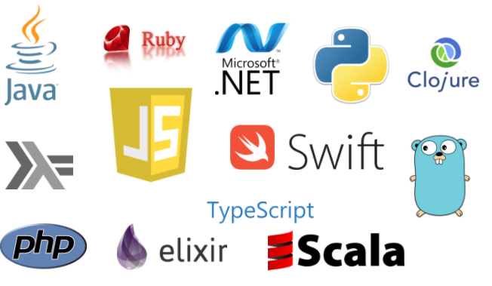
Language Supported by GraphQL
C# / .NET
Clojure
Elixir
Erlang
Go
Groovy
Java
JavaScript
PHP
Python
Scala
Ruby

Slide 10
Node.JS NPM package Install
npm init
npm install graphql --save
Install & Configure Node.JS

Slide 11
.Net/C# GraphQL nuGet library
graphql-dotnet: GraphQL for .NET
graphql-net: Convert GraphQL to IQueryable
Hot Chocolate: GraphQL Server for .net core and .net classic
Install & Configure in .Net/C#

Slide 12
PHP Composer Library
graphql-php: A PHP port of GraphQL reference implementation
graphql-relay-php: A library to help construct a graphql-php server supporting react-relay.
Install & Configure in PHP

Slide 13
GraphiQL
Install NodeJs express Tool
https://github.com/graphql/graphiql
ChromeiQL
Install Chrome Browser Extension
https://chrome.google.com/webstore/detail/chromeiql/fkkiamalmpiidkljmicmjfbieiclmeij?hl=en
GraphQL Playground
Install EXE
https://github.com/prisma/graphql-playground
Understanding Tools

Slide 14
Schema
A GraphQL schema is at the center of any GraphQL server implementation and describes the functionality available to the clients which connect to it.
Type
GraphQL is a strongly typed language.
Type System defines various data types that can be used in a GraphQL application.
The type system helps to define the schema, which is a contract between client and server.
List of Types
Scalar Type
Object Type
Query Type
Mutation Type
Interface Type
Union Type
Enum Type
Input Type
Types & Schema

Slide 15
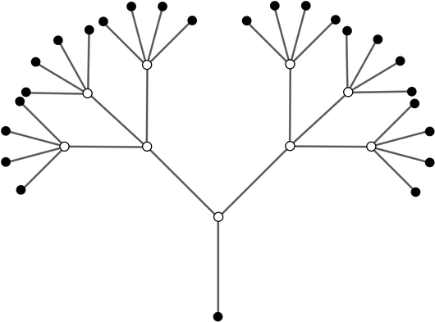
Scalar types represent primitive leaf values in a GraphQL type system.
GraphQL responses take the form of a hierarchical tree; the leaves on these trees are GraphQL scalars.
Scalar Type
Built‐in Scalars
Int
Float
String
Boolean
ID
Custom Scalars
EmailAddress
USCurrency
PhoneNumber
URL
DateTime
Syntax
field: data_type

Slide 16
The object type is the most common type used in a schema and represents a group of fields.
Each field inside an object type maps to another type, thereby allowing nested types.
In other words, an object type is composed of multiple scalar types or object types.
Object Type
Syntax
type object_type_name
{
field1: data_type
field2:data_type
....
fieldn:data_type
}

Slide 17
Entry point type to other specific types
A GraphQL query is used to read or fetch values.
It is not mandatory to pass “query” word in each
query
Query Type
Syntax 1
query query_name{ someField }
Syntax 2
{ someField }

Slide 18
Mutation is also an entry point type
It can be used to insert, update, or delete data.
Mutation also has a returned value, just like query
Mutation Type
Syntax
mutation{
someEditOperation(dataField:"valueOfField"):returnType
}

Slide 19
In the GraphQL schema language, input types look exactly the same as regular object types, but with the keyword input instead of type:
Mostly it is used with mutation type for data operation like add,edit and delete.
Input Type
Syntax
Input object_input_name
{
field1: data_type
field2:data_type
....
fieldn:data_type
}

Slide 20
Also called Enums, enumeration types are a special kind of scalar that is restricted to a particular set of allowed values.
It is used for fix data. For e.g weekdays, months, and measurements Units.
Enum Type
Syntax
Enum object_enum_name
{
Data
Data
....
Data
}

Slide 21
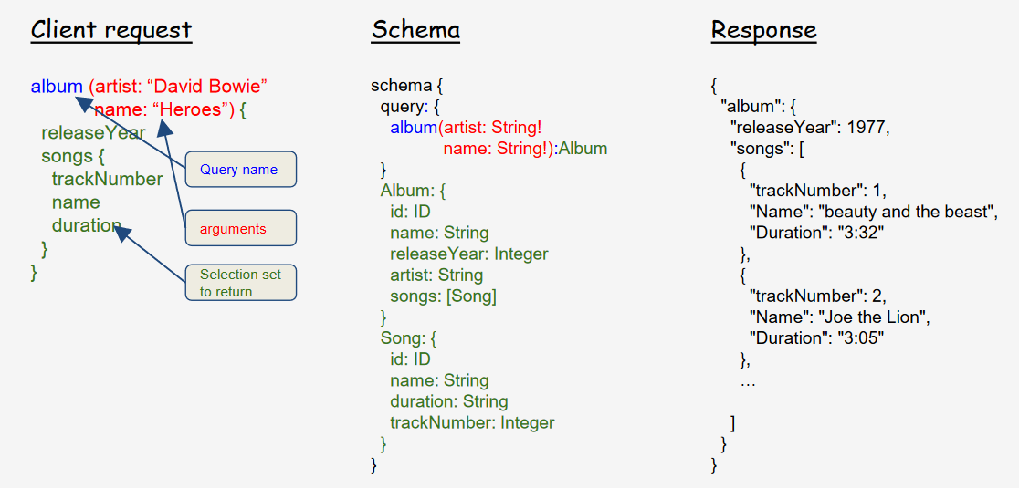
Syntax & Language

Slide 22
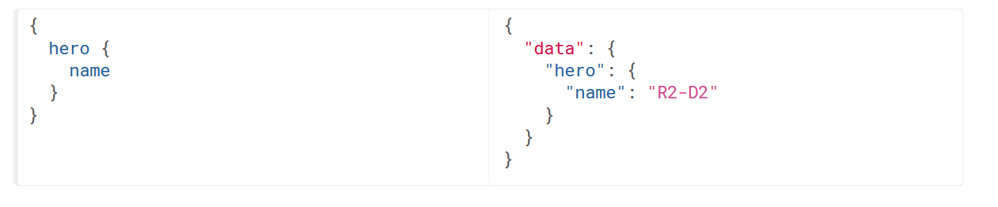
At its simplest, GraphQL is about asking for specific fields on objects.
Fields

Slide 23
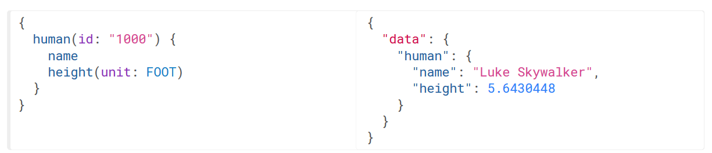
GraphQL Argument is very useful for data fetching.
We can define any number of arguments.
It helps to get specific data fetching like
Page limit, filter option.
Arguments

Slide 24
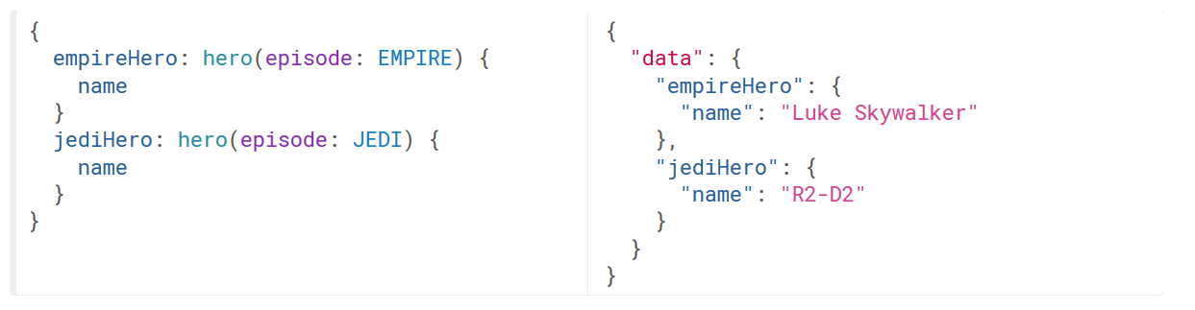
Aliases
It used for rename the result of a field to anything you want.

Slide 25
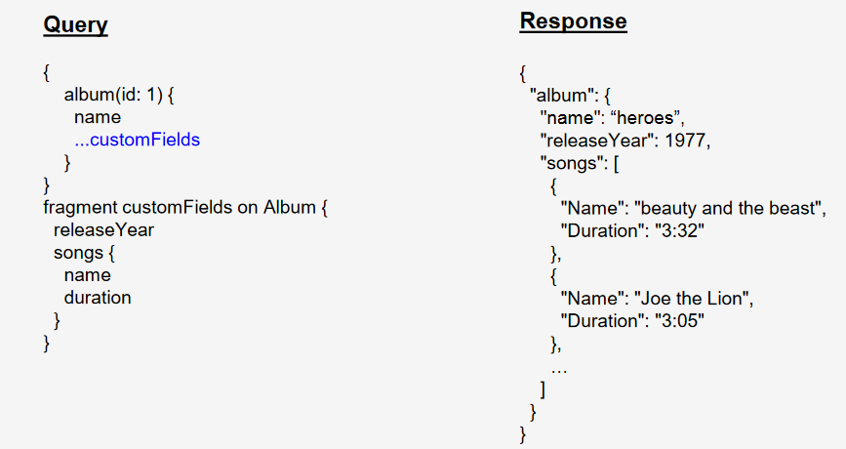
Fragments are aliases for a bundle of fields.
Fields in fragments are added at the same level of invocation as adjacent fields.
Syntax-prefixed with ...
Fragments

Slide 26
Each object in the schema should be provided with a resolver.
The resolver is a piece of code that does the actual work -fetches the results from the storage layer.
GraphQL server will take care of combining the objects and returning only the selection set fields.
Resolver

Slide 27
GraphQL APIs are required to be self-documenting.
According to the specification, every GraphQL API needs to respond to queries about its own structure.
This system is called introspection, and an introspection query starts with the __schema field present on every GraphQL API that hasn’t intentionally disabled it.
Introspection

Slide 28
PHP Sample Example
Shopify
Movies
Live Example

Slide 29
Further Reading
https://github.com/chentsulin/awesome-graphql github repo with many links to tutorials, libraries in various languages, blogs, videos and more
http://graphql.org/learn
https://www.graphqlhub.com - playground on various public GraphQL API. good place to learn the syntax
https://www.howtographql.com/ - How to GraphQL

Slide 30

Question?

Slide 31

Thanks!
Try GraphQL,
You'll like it.

